Slide 1

DESIGN THINKING PROJECT
How might we make the chaotic Ameerpet Metro interchange station less stressful, less confusing, and more navigable for first-time and elderly travelers during peak hours?
“
A Design Thinking Case Study — Ameerpet Metro Interchange Experience
TEAM MEMBERS
L. Nikitha 1602-24-733-315
A. Praharsha 1602-24-733-319
Rahul 1602-24-733-159
Sharath Kumar 1602-24-733-176
S. Aravind 1602-24-733-136

Slide 2




USER RESEARCH
Meet the Three Personas
RAMESH KUMAR
ANYA REDDY
SURESH RAO
Age 65
Age 20
Age 45
OCCUPATION: Retired Government Employee
OCCUPATION: College Student
OCCUPATION: Sales Executive
USER TYPE: Elderly first-time / occasional traveler
USER TYPE: First-time Ameerpet interchange traveler
USER TYPE: Occasional metro traveler
Tech Comfort: Low–Moderate
Tech Comfort: High
Tech Comfort: Moderate
TRAVEL PURPOSE: Hospital visits, family visits, personal work
TRAVEL PURPOSE: College, shopping and meeting friends
TRAVEL PURPOSE: Frequently travels with a suitcase / laptop bag
GOAL
GOAL
GOAL
Navigate the interchange safely, find the correct platform, and reach his destination without depending repeatedly on others.
Change metro lines quickly, find the correct platform and reach her destination on time.
Find the shortest accessible route with minimum walking and easily locate lifts/escalators.
PAIN POINT
PAIN POINT
PAIN POINT
Crowds, unfamiliar layout, difficulty finding lifts/platforms, fear of the wrong train, unnecessary walking.
Information overload, crowded pathways, unclear directions, fear of following the wrong crowd, exit confusion.
Moving with luggage through crowds, long interchange walks, hard-to-find lifts, stairs and wrong turns.
PRIMARY NEED
PRIMARY NEED
PRIMARY NEED
Simple, accessible and highly visible guidance.
Fast, intuitive and easy-to-follow navigation.
Accessible, convenient and low-effort navigation.
Personas represent design-research assumptions for empathy-building — not findings from conducted interviews.
2

Slide 3




EMPATHY MAPPING-Persona 1
What Our Users Say, Think, Do & Feel
SAYS
THINKS
“Which platform should I go to?”
“Where do I change the line?”
“Where is the lift or escalator?”
“Is this train going towards my destination?”
“Which exit should I take?”
“Am I going in the correct direction?”
“What if I board the wrong train?”
“I don’t want to miss my train.”
“There are too many people and directions.”
“There should be an easier way to navigate.”
DOES
FEELS
Stops frequently to check signs.
Follows the crowd when unsure.
Checks route information on a phone.
Asks passengers or metro staff for help.
Searches for lifts and escalators; double-checks platform & direction.
Confused by multiple directions.
Anxious about choosing the wrong platform.
Overwhelmed by peak-hour crowds.
Rushed by fast-moving commuters.
Tired after walking, relieved once on the right route.
Passengers need guidance that can be understood within seconds while moving through a crowded interchange.

Slide 4
EMPATHY MAPPING-Persona 2
What Our Users Say, Think, Do & Feel
SAYS
THINKS
“Which line should I change to?”
“Where is my next platform?”
“Which direction should I follow?”
“Is this the fastest route?”
“Which exit should I take?”
“I don't want to miss my train.”
“Am I following the correct route?”
“Maybe I should just follow the crowd.”
“Why isn't there a simpler way to navigate?”
“I need to reach on time.”
DOES
FEELS
Checks route information on her phone.
Looks at digital displays and signboards.
Walks quickly between platforms.
Follows color codes and arrows.
Follows other commuters when uncertain.
Asks for help only when necessary.
Confused when seeing multiple directions.
Rushed because of time pressure.
Anxious about missing the train.
Frustrated when she takes a wrong turn.
Uncertain during the interchange.
Confident once the correct route is confirmed.
Passengers need guidance that can be understood within seconds while moving through a crowded interchange.

Slide 5
EMPATHY MAPPING-Persona 3
What Our Users Say, Think, Do & Feel
SAYS
THINKS
“Where is the nearest lift?”
“Is there a shorter route?”
“Can I avoid the stairs?”
“Which platform should I go to?”
“Is there an easier way with my luggage?”
“I don't want to carry my luggage too far.”
“I hope I don't have to walk back.”
“Where is the nearest lift or escalator?”
“This crowd is difficult to move through.”
“I need to reach the platform on time.”
DOES
FEELS
Searches for lifts and escalators.
Avoids stairs whenever possible.
Moves slowly through crowded areas.
Checks signs before choosing a route.
Looks for the shortest path.
Asks staff for accessible directions when required
Frustrated when lifts are difficult to locate.
Tired from carrying luggage.
Uncomfortable in dense crowds.
Rushed when the train is approaching.
Worried about taking a wrong route.
Relieved when he finds an accessible path.
Passengers need guidance that can be understood within seconds while moving through a crowded interchange.

Slide 6





DESIGN BRIEF
From Interchange Confusion to Confident Navigation
PROBLEM First-time and elderly passengers can experience confusion and stress while navigating Ameerpet Metro interchange during peak hours. Heavy crowds, unfamiliar layouts, multiple directions, platform uncertainty and difficulty locating accessible routes can lead to wrong turns, unnecessary walking and dependence on others.
TARGET USERS
DESIGN GOALS
CONSTRAINTS
SUCCESS CRITERIA
First-time metro travelers
Elderly passengers
Occasional travelers
Passengers with luggage
Divyang passengers
Reduce confusion & navigation errors
Reduce unnecessary walking
Improve accessibility
Reduce dependence on staff/strangers
Improve interchange confidence
Make info understandable in seconds
Support peak-hour navigation
Reduce confusion while navigating the interchange.
Help passengers find the correct platform quickly.
Reduce unnecessary walking and wrong turns.
Make interchange routes easier to understand.
Improve visibility of lifts, escalators, and exits.
Reduce dependence on staff for directions.
Make navigation easier during peak-hour crowds.
Improve accessibility for elderly and first-time travelers.
Reduce passenger stress while changing lines.
Increase confidence in independent navigation.
Heavy peak-hour crowds
Existing station infrastructure
Limited physical space
Multilingual passenger population
Accessibility requirements
Avoid visual information overload
Cannot depend entirely on smartphones
Safety & emergency regulations
SEE
CONFIRM
INTERCHANGE
REACH
Ameerpet Metro Interchange · Design Thinking Project
7

Slide 7
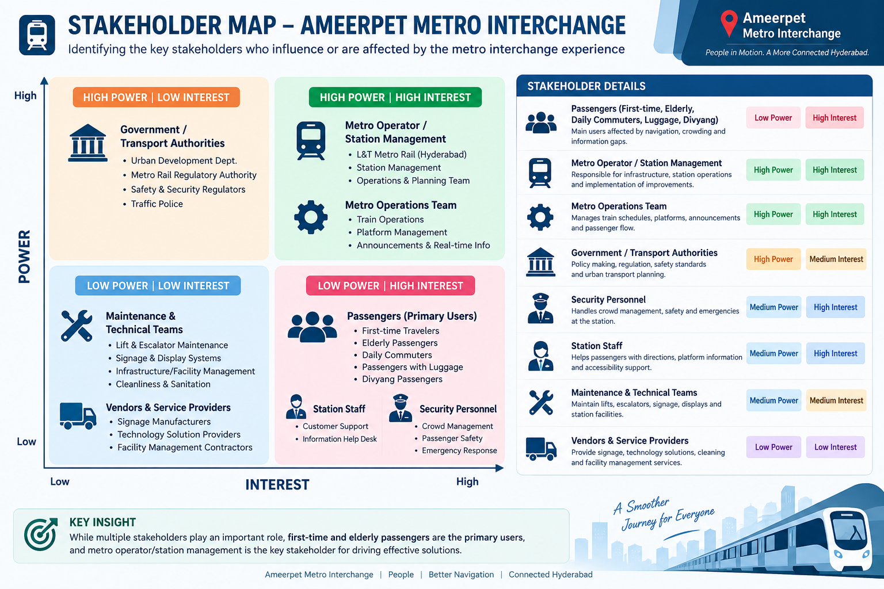



STAKEHOLDER MAP
Who Has Power & Interest in This Problem?
HIGH POWER · HIGH INTEREST
HIGH POWER · MEDIUM INTEREST
Manage Closely
Keep Satisfied
Metro operator / station management
Metro operations team
Government / transport authorities
Safety & regulatory authorities
MEDIUM POWER · HIGH INTEREST
Keep Informed / Involve
Design Focus
LOW POWER · HIGH INTEREST — PRIMARY
USERS
Station staff
Security personnel
Maintenance teams
First-time travelers
Elderly passengers
Daily commuters
Passengers with luggage
Divyang passengers
Primary Users: First-time and Elderly Travelers — the core focus of this design.

Slide 8

CONTEXTUAL INQUIRY
Context Map — Ameerpet Metro Interchange
PASSENGER FLOW
METRO / STAFF FLOW
KEY OBSERVATIONS
Enter Station
Monitor passenger movement
Peak-hour passenger density increases navigation difficulty.
First-time users do not have a mental map of the station.
Passengers must make decisions while moving with the crowd.
Interchange routes require the highest cognitive effort.
Elderly travelers benefit from shorter routes and clearly visible lifts/escalators.
Too much information can be as confusing as too little information.
Passengers frequently seek confirmation before boarding.
Digital-only solutions may exclude some elderly users.
Check Route / Line
Provide signage & announcements
Reach Platform
Manage platforms
Board Train
Handle peak-hour crowds
Interchange
Assist confused passengers
Find Connecting Platform
Board
Maintain lifts/escalators
Exit
Respond to incidents
Navigation must work in a noisy, crowded and fast-moving environment.

Slide 9





CUSTOMER JOURNEY MAP
From Entering Ameerpet Metro to Reaching the Destination
1
2
3
4
5
6
7
ENTER STATION
FIND ROUTE
REACH PLATFORM
INTERCHANGE
CONFIRM PLATFORM
BOARD TRAIN
EXIT / DESTINATION
Looks for initial directions.
Checks route map, line & platform info.
Follows signs/arrows through the crowd.
Gets off, searches for connecting line.
Checks platform number & train direction.
Boards after confirming destination.
Finds the correct exit.
EMOTIONAL JOURNEY
Uncertain
Confused
Anxious
Stressed
Doubtful
Relieved
Confident
PROBLEM FLOW
Crowd
Information
Overload
Wrong Direction
Risk
Interchange
Confusion
Extra
Walking
Stress
OPPORTUNITY FLOW
Clear Entry
Map
Color-Coded
Route
Floor
Guidance
Clear Interchange
Path
Platform
Confirmation
Numbered Exit
Guidance
The interchange stage is the critical pain point in the entire journey.
Ameerpet Metro Interchange · Design Thinking Project
4

Slide 10






OPPORTUNITY AREAS
Towards a Stress-Free Ameerpet Metro Interchange
1
2
3
4
CLEAR WAYFINDING
COLOR-CODED PATHS
“YOU ARE HERE” MAPS
ACCESSIBLE ROUTE GUIDANCE
Large, readable, consistent directional signs.
Line colors & floor markings connect routes.
Simple maps at key decision points.
Identify lifts, escalators & shorter routes.
5
6
7
PLATFORM CONFIRMATION
MULTILINGUAL + AUDIO
SMART NAVIGATION SUPPORT
Show platform, direction & destinations before boarding.
Telugu, Hindi, English, symbols & audio support.
Digital displays, QR maps, optional mobile guidance.
EXPECTED IMPACT
LESS
FEWER
SHORTER
BETTER
LOWER
HIGHER
SMOOTHER
Confusion
Wrong turns
Unnecessary walking
Accessibility
Stress
Passenger confidence
Passenger movement
FINAL DESIGN VISION
“Create an intuitive metro interchange where passengers always know where they are, where they need to go, and how to get there.”
Note: These are proposed opportunity directions for further ideation — not implemented solutions.
Ameerpet Metro Interchange · Design Thinking Project
8

